Slide 1
CLIMATE CHANGE
Lauren McCarthy, Shalyn Lavoie, Nicole Pierre, and Moriah Taylor

Slide 2
OBJECTIVES
Brief overview of the topic and what motivated us to further explore climate change
How and where we found our data
The data exploration and clean up process
Data analysis
Conclusions
Implications

Slide 3
MOTIVATION & SUMMARY
Rising temperatures, extreme weather, and natural disasters are experienced globally each year. These changes in our environment indicate a need for adaptability over time across the globe.
Data has been gathered to reveal the population growth, greenhouse gases and other factors that may have a strong correlation of a rising sea level and the average temperature per country.
The data that was found reveals strong indicators of what is advancing the climate change.

Slide 4
Data Exploration and Cleanup
Narrowed down variables to search and pull data from four different sources by googling climate change datasets
Wanted to get the most complete data we could, which meant looking for multiple specific datasets rather than one large general dataset
Cleaned each dataset individually
Renamed columns to be more intuitive and enable merging
Merged datasets together based on research question

Slide 5
DATA ANALYSIS

Slide 6
GLOBAL EMISSIONS OVERTIME

Slide 7
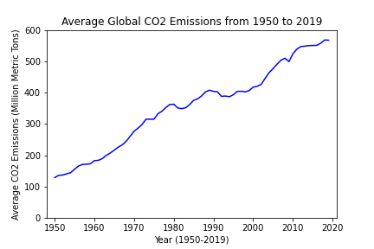
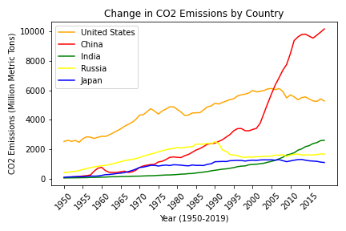
Emissions overtime
Global emissions have been rising over the years as seen when considering the average CO2 emissions (the largest contributor to overall emissions) from 1950 to 2019.
Within this increase, there is variability in emissions around the world with some countries contributing significantly more to overall emissions than others.
Notes:
Seen in graph 2 are some of the higher contributing countries - even here we can see variability.

Slide 8
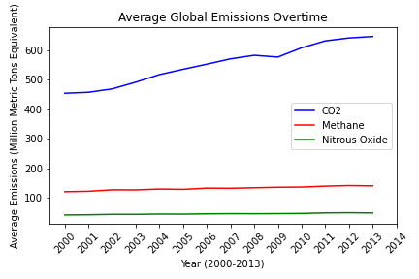
Narrowing our focus
The three largest contributors to greenhouse gases are CO2, methane, and nitrous oxide - with CO2 being the most significant contributor globally.
Here we can see that even when narrowing our timeframe to 2000 - 2013, we can see a significant increase in emissions (specifically with CO2).
Notes:
Fluorinated gases are also considered a greenhouse gas but these were not included in our dataset and only make up a very small percentage of total GhG.

Slide 9
POPULATION GROWTH AND CLIMATE CHANGE

Slide 10
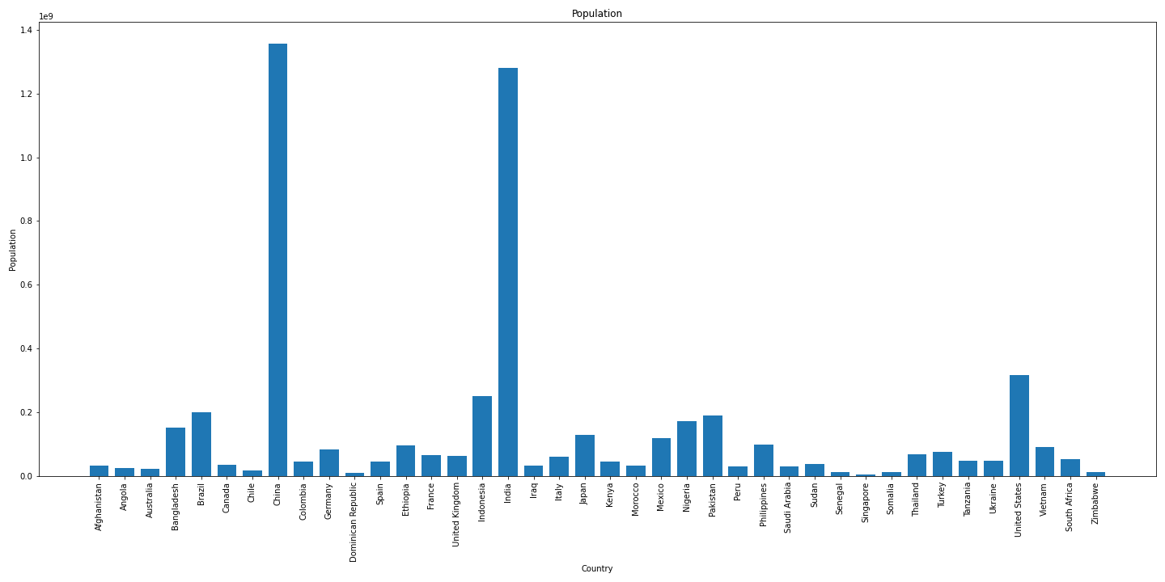
Population

Slide 11
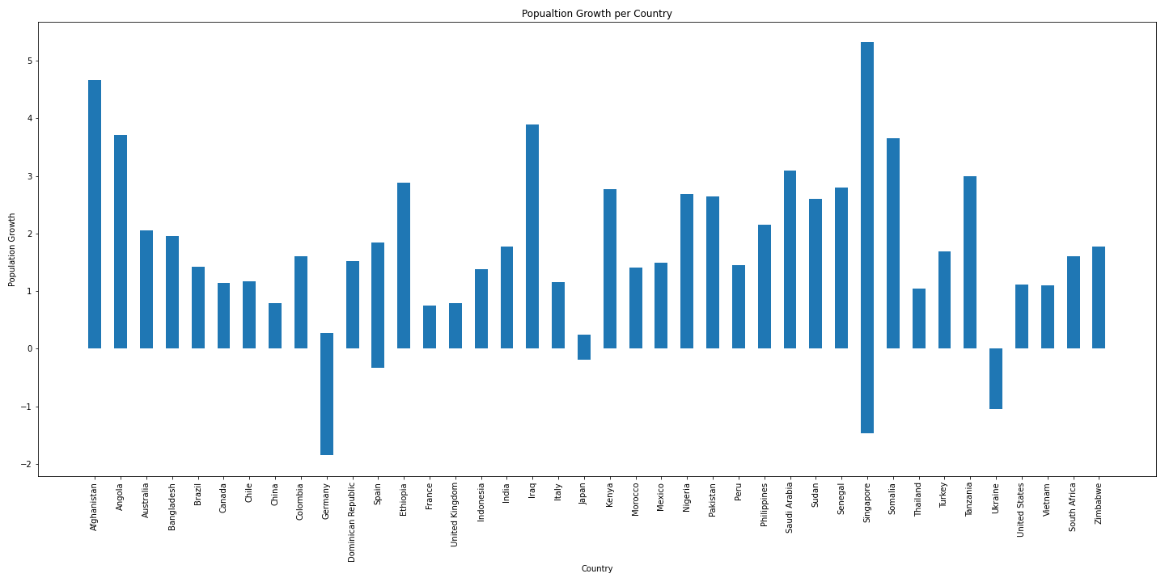
Population Growth
Looking at the data provided, Germany, Japan, Singapore, and Ukraine have a net negative decline in population growth while other countries have a positive increase in population growth.

Slide 12
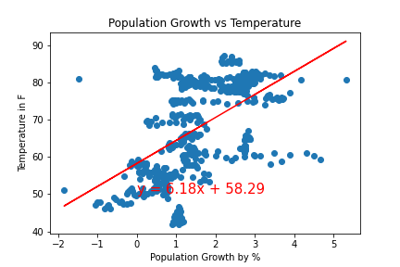
Population Growth Vs Average Temperature
Looking at the correlation coefficient of 0.52, we can see that the population growth and average temperature are moderately correlated.
With an R-squared value of 0.26, we can also see that in comparing the average temperatures and the population growth we have substantial data.
Comparing population growth to average temperature the data shows that there is a correlation.

Slide 13
TEMPERATURE CHANGE AND EMISSIONS RELATED TO EXTREME WEATHER

Slide 14
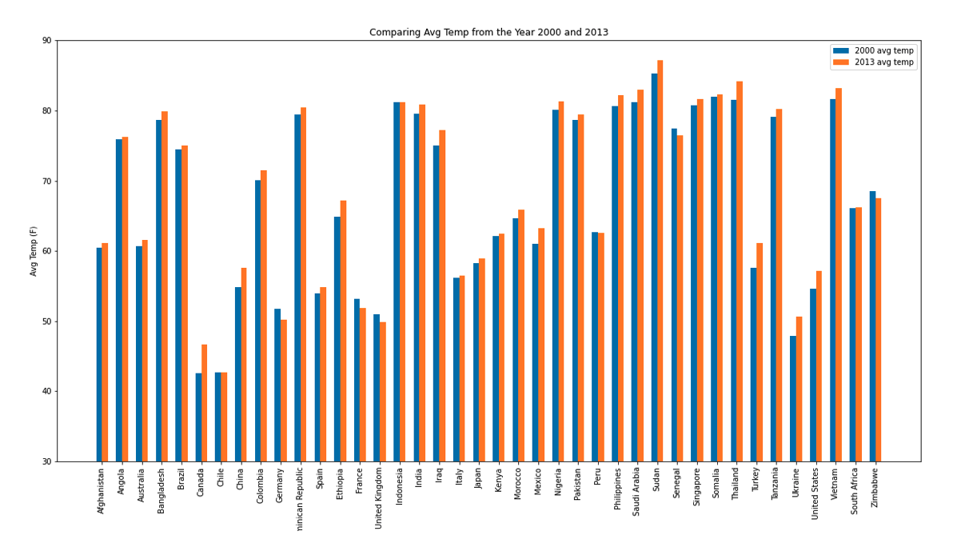
Average Temperature per Country
Looking at the grouped bar graph comparing average temperature from the year 2000 and 2013, most countries have had a multiple-degree increase in average temperature.

Slide 15
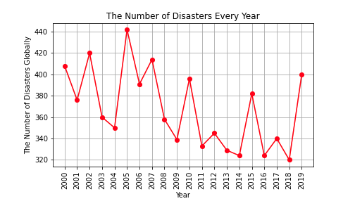
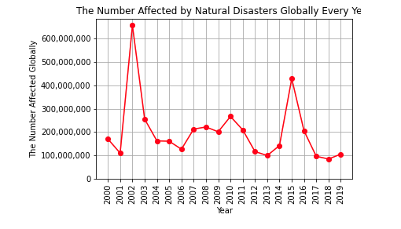
Total Affected and Number of Disasters per Year
Every 2-3 years there is a spike in the number of disasters (Number of Disasters Every Year)
There is not a spike in those affected in the same years that the number of disasters spike (Number of Affected by Natural Disasters Globally)
This shows that the disasters are not getting worse or more dangerous, but rather that they are happening at a higher, more frequent rate.

Slide 16
COUNTRIES MOST AT RISK

Slide 17
Countries of Interest
United States
China
Germany - European Union (EU)
Bangladesh - Least-Developed Countries (LDC)
Dominican Republic - Small Island Developing States (SIDS)
Saudi Arabia - Organization of Petroleum Exporting Countries (OPEC)

Slide 18
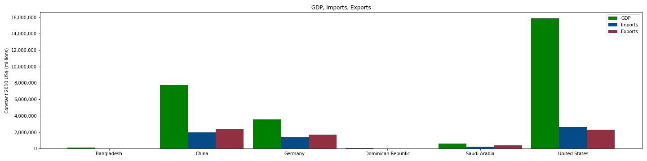
Economies
The economies of the United States, China, and Germany completely dwarf those of Bangladesh, Dominican Republic, and Saudi Arabia

Slide 19
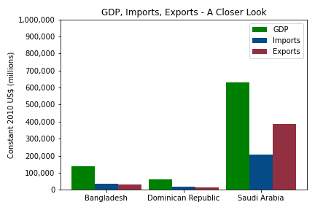
Economies: A Closer Look
Even the oil-producing country of Saudi Arabia still has a GDP below 700,000 million USD
Both Bangladesh and Dominican Republic have minimal imports and exports

Slide 20
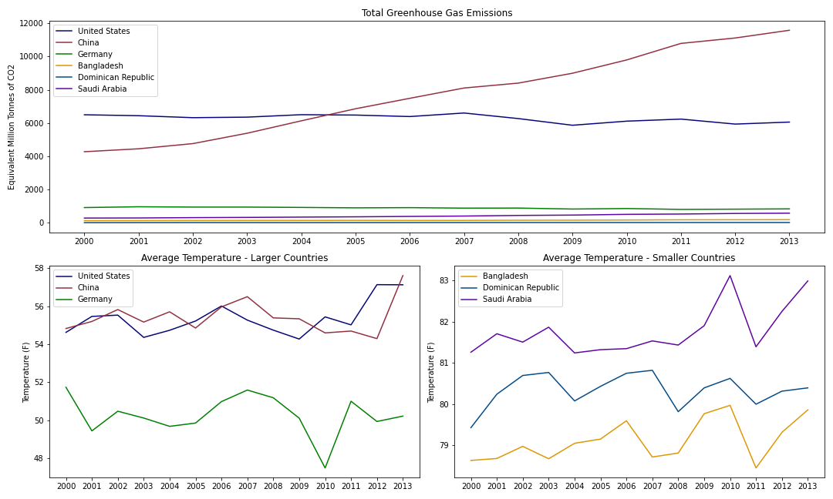
─ Emissions and Temps ─

Slide 21
CONCLUSIONS
&
IMPLICATIONS

Slide 22
WHAT DOES THIS ALL MEAN?

Slide 23
Conclusions and Implications
Emissions continue to rise across the world, with some countries having a larger impact on the rising levels of greenhouse gases.
Increased emissions leads to an increase in temperatures, which can result in more extreme weather events. Least-developed countries and small island countries are more vulnerable to these events.
The world must continue to assess the changing climate and act responsibly to reduce the damage already made to our environment, as well as limit further damage.

Slide 24
Reflections and Considerations
Challenges:
Lack of consistency among countries
Narrowing down such a broad topic to a few specific questions
Multiple large datasets
Missing data
Other Directions:
Adding an API
Precipitation data

Slide 25
Data Resources
General Statistics (Population, GDP, etc): The World Bank DataBank (https://databank.worldbank.org/home.aspx)
Emissions: Our World in Data (https://ourworldindata.org/co2-and-other-greenhouse-gas-emissions)
Temperature: Kaggle (https://www.kaggle.com/berkeleyearth/climate-change-earth-surface-temperature-data)
Disasters/Extreme Weather: EM-DAT International Disasters Database (https://www.emdat.be/)

